Slide 1

Tips and Tricks For Report Writing and Overview of Second Progress Review
Dr H. M. Pandey
Computing and Informatics, Bournemouth University
hpandey@bournemouth.ac.uk

Slide 2

Agenda
1. Clarification on words count.
2. Presenting results and discussion
3. Writing conclusions and future work
4. Tips for good report writing
5. Tip for video presentation
6. Handling students queries
7. Any other points related to project

Slide 3
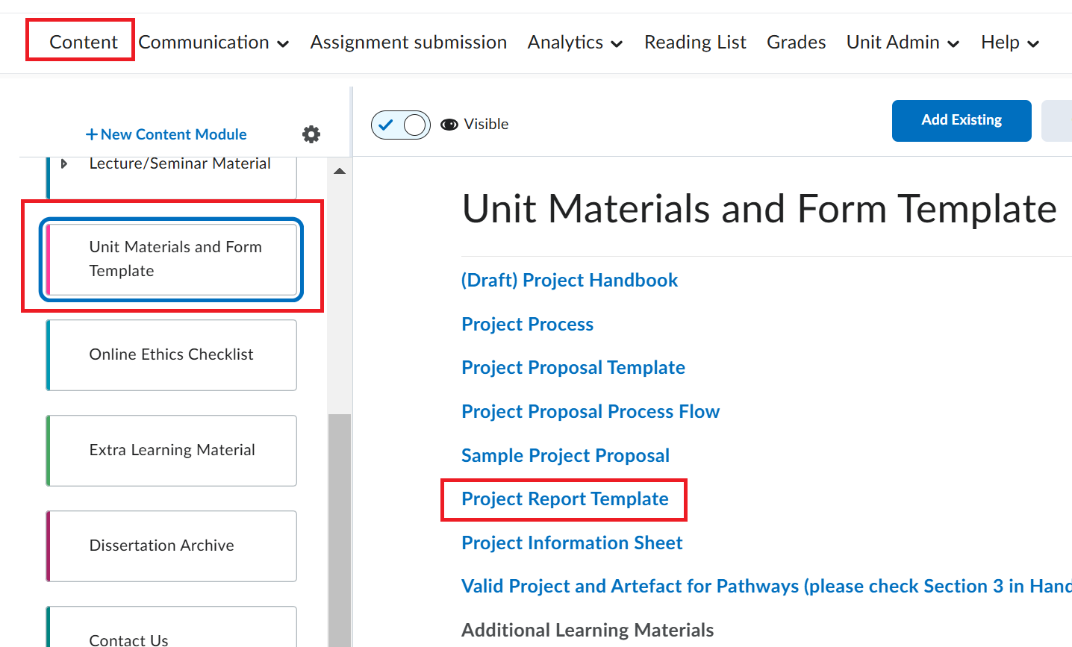
Project Report Template

Slide 4
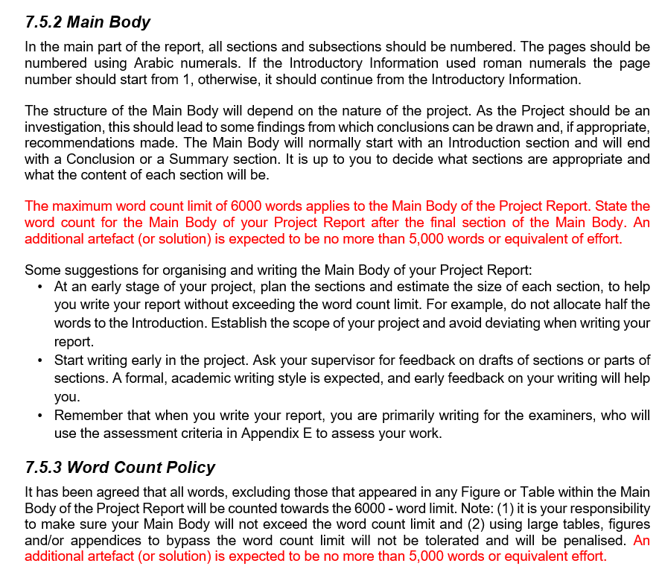
Word Count
Refer: Master project handbook for detailed information

Slide 5

Results and Discussion
Results should be very focused.
Make sure you have achieved the objectives through the results.
Presenting results are not good enough.
You should discuss the results.
Discuss how the results are better.
Discuss novelty by showing comparisons with existing methods or using benchmarks.

Slide 6

Writing conclusions and future work
Present a clear conclusions.
Conclusion should be reflective – it means you should discuss how the objectives and research questions were achieved.
You should present at least few future works which have not been achieved due to multiple reasons (e.g. lack of timing, etc.)

Slide 7

Tips for good report writing
Make sure you have used what has been recommended for writing report.
Make sure you have used correct font size.
Make sure your report is properly aligned.
Make sure you have presented references in correct referencing style.
Make sure all the references have been cited correctly in the main body of the report.

Slide 8
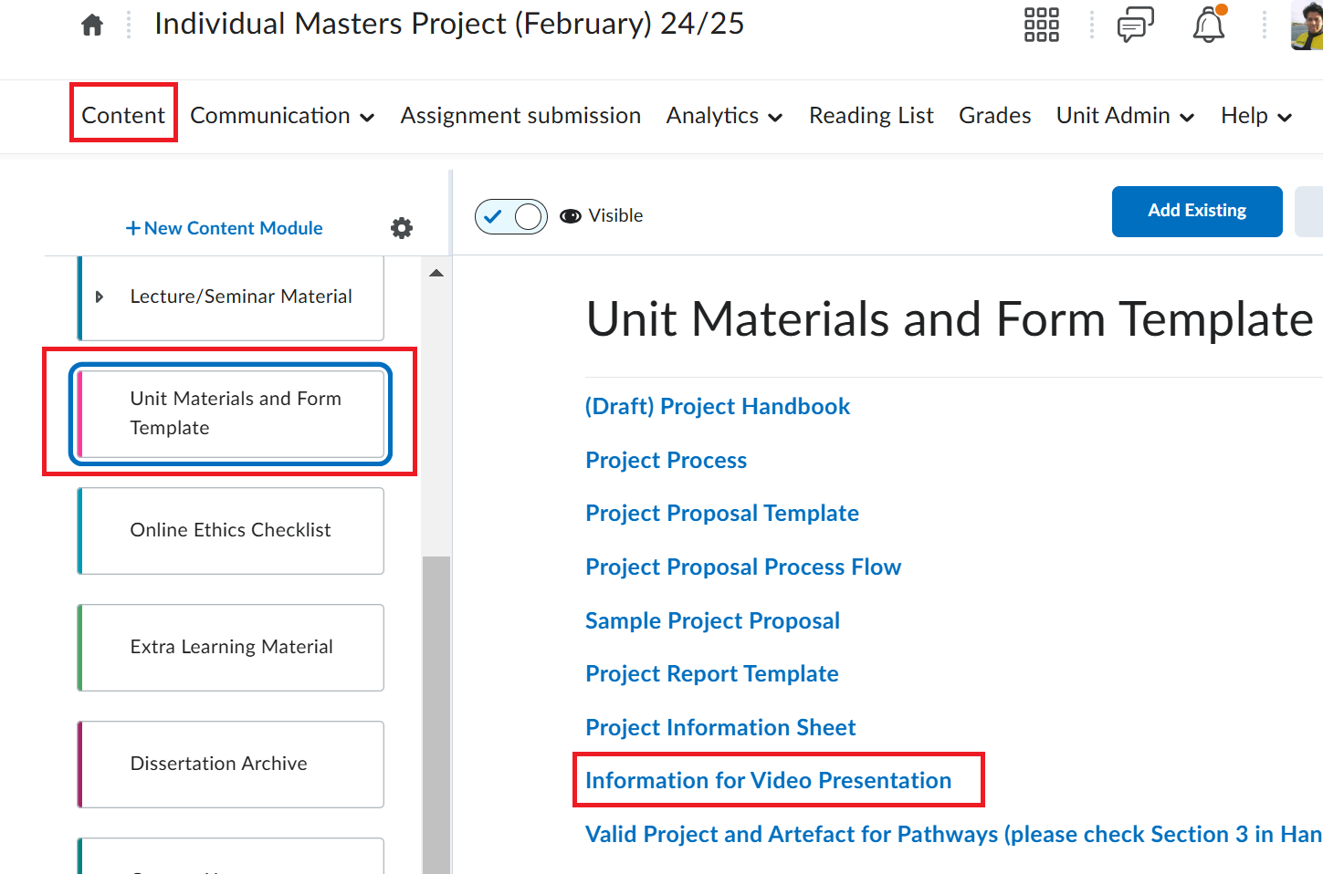
Tip for Video Presentation
Please refer video presentation information under Assessment in Brightspace.
Refer:
Section 7.5.10 in Project Handbook

Slide 9
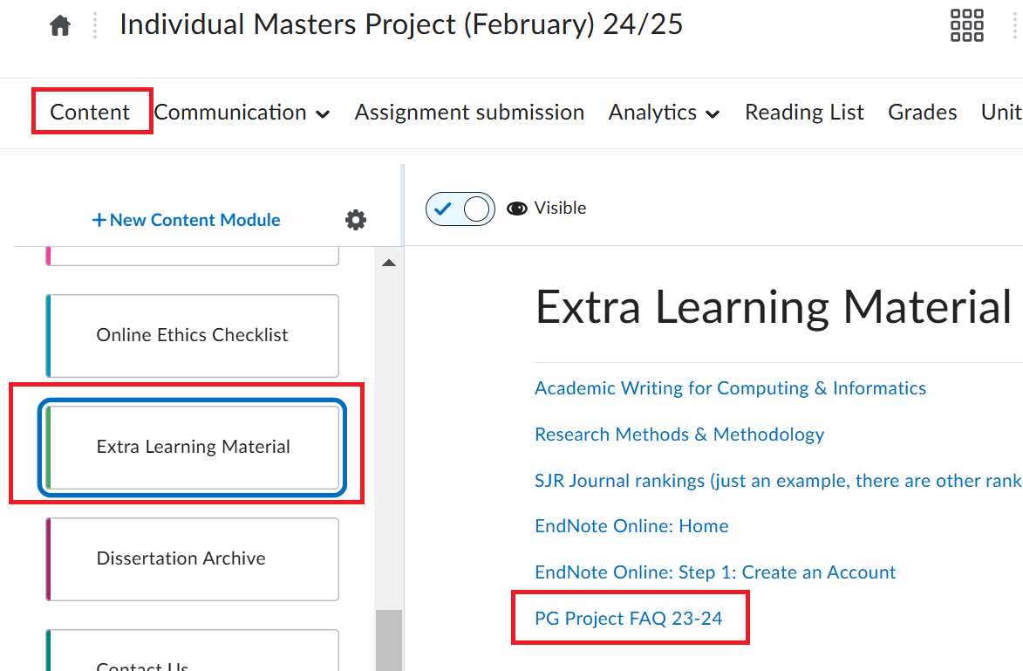
Frequently Asked Questions
FAQ is available in Brightspace.

Slide 10
Contact and Support
First contact to your supervisor for support in the project.
Response time is 3 working days
If you do not get a response in 3 working days, then send a reminder and wait for 2 working days.
If you do not get a response after sending a reminder then contact to the project coordinator immediately.

Slide 11
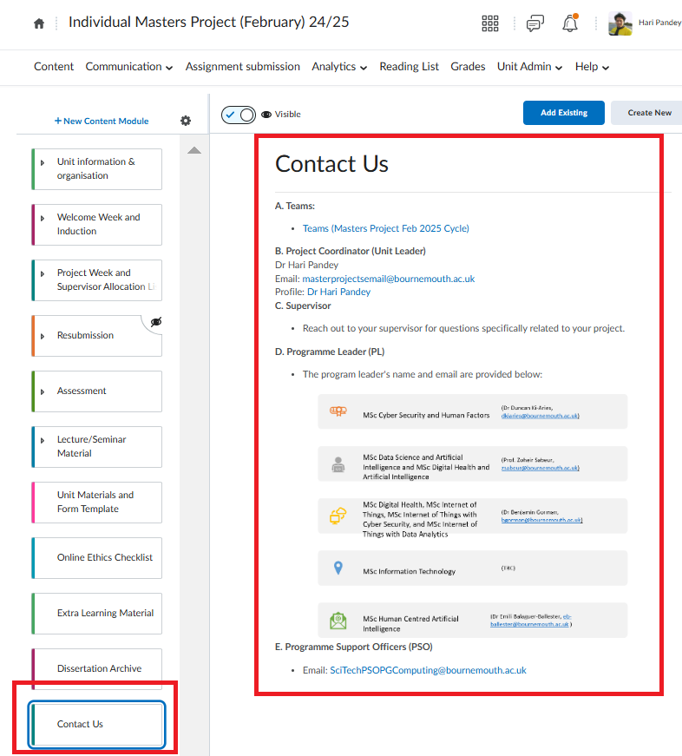
Contact Details

Slide 12
Students' queries
Any Questions?

Slide 13
Thank You!

